Slide 1

CSS Review
Ranken Technical College

Slide 2
Objectives
Apply styles with Inline Styles, Embedded Stylesheets, and External Stylesheets
Understand the CSS Box Model
Use CSS Flexbox to implement page layouts
Use the main CSS selectors: type, class, id
Use CSS relational selectors: descendent and direct descendent
Use CSS properties to change background and foreground colors
Use CSS properties to style text

Slide 3
Applying Styles
Inline Styles, Embedded Stylesheets, and External Stylesheets

Slide 4
Inline Styles
You could apply styles directly to an individual element.
In <body> of HTML document:
<h1 style="color: blue;">Blue h1</h1>
However...

Slide 5
Inline Styles
You could apply styles directly to an individual element.
In <body> of HTML document:
<h1 style="color: blue;">Blue h1</h1>
However, this is very poor style and should be avoided at all costs.
Inline styles have the highest precedence possible and cannot be overridden with a stylesheet.
They cannot be overridden responsively using media queries. (See first point.)
They cannot be re-themed. (See first point.)
They cause styling data to be scattered and duplicated across the application.

Slide 6
Embedded Stylesheets
Embedded stylesheets are generally placed in the <head> of the HTML document and are used to apply styles to a particular page.
In <head> of HTML document:
<style>
h1 { color: blue; }
</style>

Slide 7
External Stylesheets
External stylesheets are generally placed in a folder named css.
They are used to apply styles to an entire website.
In <head> of HTML document:
<link rel="stylesheet" href="/css/main.css">
In css/main.css:
h1 { color: blue; }

Slide 8
Box Model
Understanding the CSS box model.

Slide 9
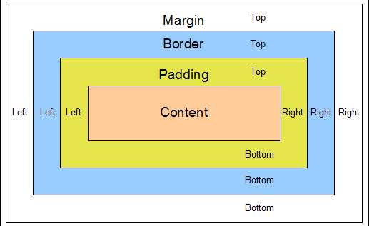
CSS Box Model

Slide 10
Definitions
Margin - Clears an area outside the border. The margin is always transparent.
Border - A border that goes around the content.
Padding - Clears an area between the border and the content.
Content - The content of the box, where text and images appear.
NOTE: Any background applied to the element is bounded by the border.
Notes:
https://developer.mozilla.org/en-US/docs/Web/CSS/box-sizing

Slide 11
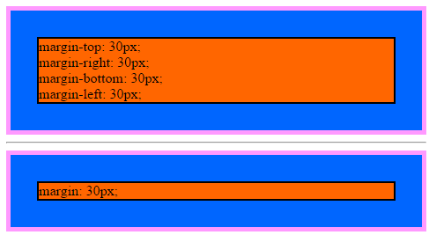
margin
The margin property sets the margin area on all four sides of an element.
It is a shorthand for margin-top, margin-right, margin-bottom, and margin-left.
margin should be measured in em or rem to follow the font size.
Examples
.m-4 { margin: 1.5rem; }
.m-3 { margin: 1rem; }
.m-2 { margin: 0.5rem; }
Source
https://developer.mozilla.org/en-US/docs/Web/CSS/margin
https://getbootstrap.com/docs/4.0/utilities/spacing/
Notes:
https://developer.mozilla.org/en-US/docs/Web/CSS/margin
https://getbootstrap.com/docs/4.0/utilities/spacing/

Slide 12
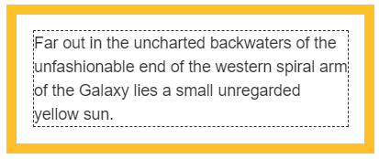
padding
The padding property sets the padding area on all four sides of an element.
It is a shorthand for padding-top, padding-right, padding-bottom, and padding-left.
padding should be measured in em or rem to follow the font size.
Examples
.p-4 { padding: 1.5rem; }
.p-3 { padding: 1rem; }
.p-2 { padding: 0.5rem; }
Source
https://developer.mozilla.org/en-US/docs/Web/CSS/padding
https://getbootstrap.com/docs/4.0/utilities/spacing/
Notes:
https://developer.mozilla.org/en-US/docs/Web/CSS/padding
https://getbootstrap.com/docs/4.0/utilities/spacing/

Slide 13
border
The border shorthand property sets an element's border.
It sets the values of border-width, border-style, and border-color.
border-width should be measured in px to avoid half pixels.
Examples
.border-black { border: 1px solid black; }
.border-red { border: 3px solid red; }
Source
https://developer.mozilla.org/en-US/docs/Web/CSS/border
https://getbootstrap.com/docs/4.0/utilities/borders/
Notes:
https://developer.mozilla.org/en-US/docs/Web/CSS/border
https://getbootstrap.com/docs/4.0/utilities/borders/

Slide 14
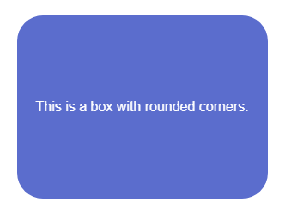
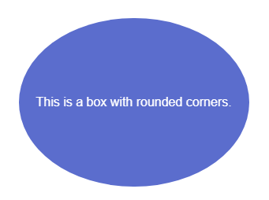
border-radius
The border-radius property rounds the corners of an element's outer border edge.
You can set a border-radius even if you haven't set a border.
border-radius should generally be measured with em or rem.
border-radius can be set to 50% to give the element a fully rounded edge.
Examples
.rounded { border-radius: 0.5rem; }
.rounded-circle { border-radius: 50%; }
Source
https://developer.mozilla.org/en-US/docs/Web/CSS/border-radius
https://getbootstrap.com/docs/4.0/utilities/borders/
Notes:
https://developer.mozilla.org/en-US/docs/Web/CSS/border-radius
https://getbootstrap.com/docs/4.0/utilities/borders/

Slide 15
background
The background shorthand property sets all background style properties at once.
It sets the values of background-color, background-image, background-origin, background-position, background-size, and background-repeat.
Examples
.bg-red { background: red; }
.bg-star { background: no-repeat left url('/images/star.png'); }
.jumbotron { background: no-repeat center/cover black url('/images/jumbo.jpg'); }
Source
https://developer.mozilla.org/en-US/docs/Web/CSS/background
https://getbootstrap.com/docs/4.0/utilities/colors/
Notes:
https://developer.mozilla.org/en-US/docs/Web/CSS/background
https://getbootstrap.com/docs/4.0/utilities/colors/

Slide 16
box-sizing
The box-sizing property sets how the total width and height of an element is calculated.
content-box
The width and height properties include the content, but do not include the padding, border, or margin.
For example, .box {width: 350px; border: 10px solid black;} renders a box that is 370px wide.
This is the default mode.
border-box
The width and height properties include the content, padding, and border, but do not include the margin.
For example, .box {width: 350px; border: 10px solid black;} renders a box that is 350px wide.
Using this mode for page layout is highly recommended.
Notes:
https://developer.mozilla.org/en-US/docs/Web/CSS/box-sizing

Slide 17
Flexbox
Using flexbox to implement page layouts.

Slide 18
What is Flexbox?
Flexbox is a one-dimensional layout model. It offers powerful space distribution and alignment capabilities not found in previous layout models.
Flexbox is the backbone of modern responsive web design.
Source
https://developer.mozilla.org/en-US/docs/Web/CSS/CSS_Flexible_Box_Layout/Basic_Concepts_of_Flexbox
Notes:
https://developer.mozilla.org/en-US/docs/Web/CSS/CSS_Flexible_Box_Layout/Basic_Concepts_of_Flexbox

Slide 19
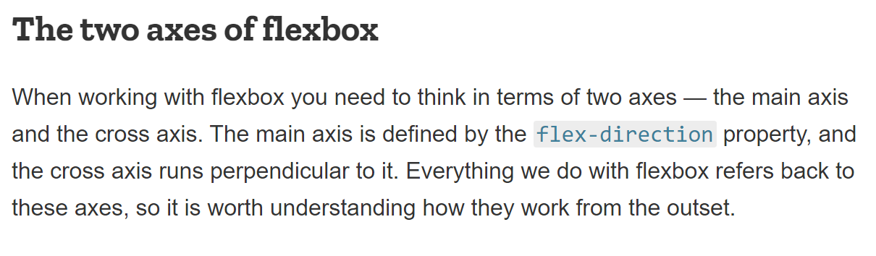
Notes:
https://developer.mozilla.org/en-US/docs/Web/CSS/CSS_Flexible_Box_Layout/Basic_Concepts_of_Flexbox

Slide 20
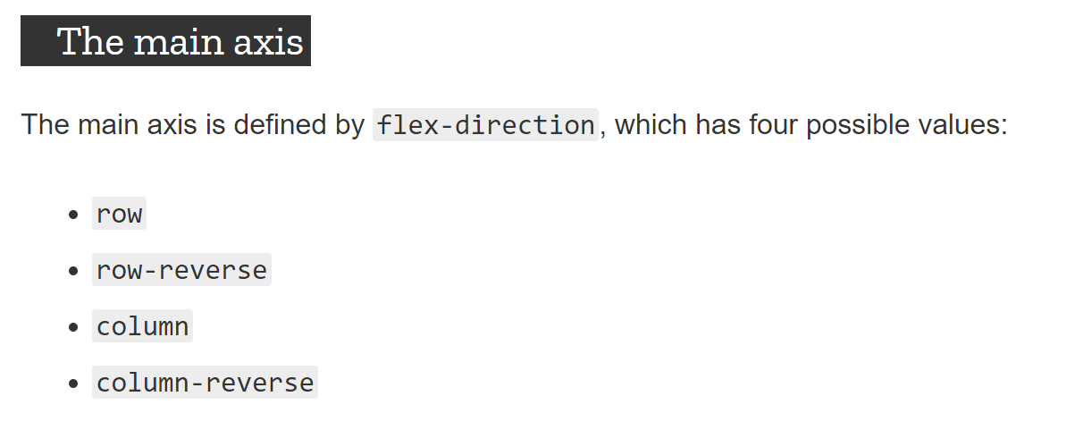
Notes:
https://developer.mozilla.org/en-US/docs/Web/CSS/CSS_Flexible_Box_Layout/Basic_Concepts_of_Flexbox

Slide 21
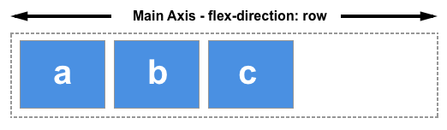
flex-direction: row
Notes:
https://developer.mozilla.org/en-US/docs/Web/CSS/CSS_Flexible_Box_Layout/Basic_Concepts_of_Flexbox

Slide 22
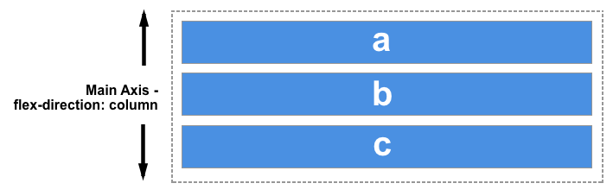
flex-direction: column
Notes:
https://developer.mozilla.org/en-US/docs/Web/CSS/CSS_Flexible_Box_Layout/Basic_Concepts_of_Flexbox

Slide 23
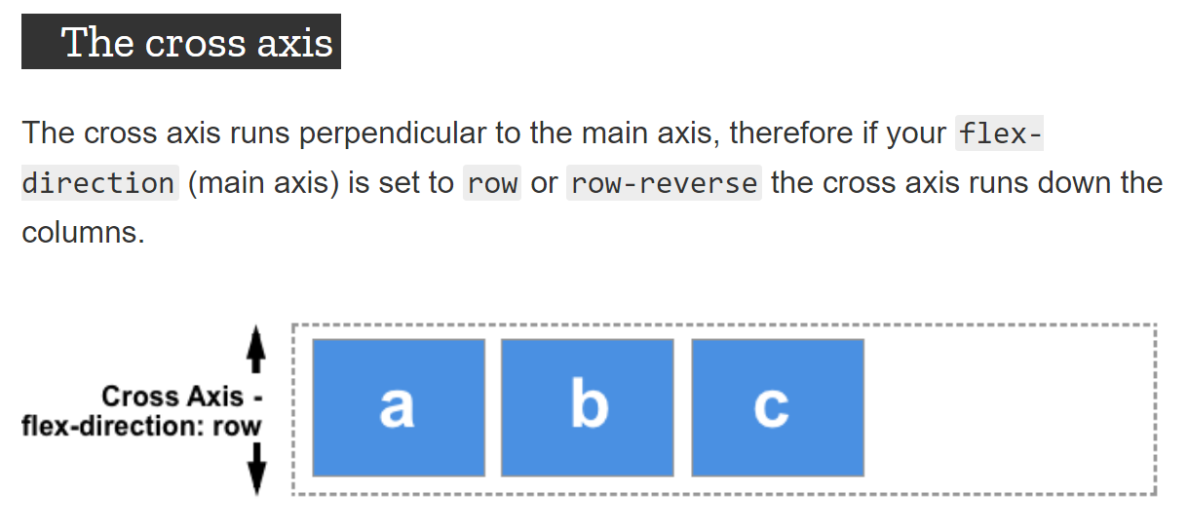
Notes:
https://developer.mozilla.org/en-US/docs/Web/CSS/CSS_Flexible_Box_Layout/Basic_Concepts_of_Flexbox

Slide 24
The flex container
An area of a document laid out using flexbox is called a flex container. To create a flex container, we set the value of the area's container's display property to flex. As soon as we do this the direct children of that container become flex items.
As with all properties in CSS, some initial values are defined, so when creating a flex container all of the contained flex items will behave in the following way.
Items display in a row (the flex-direction property's default is row).
The items are aligned to the start edge of the main axis.
The items do not stretch on the main dimension, but can shrink.
The items will stretch to fill the size of the cross axis.
The flex-basis property is set to auto.
The flex-wrap property is set to nowrap.
Notes:
https://developer.mozilla.org/en-US/docs/Web/CSS/CSS_Flexible_Box_Layout/Basic_Concepts_of_Flexbox

Slide 25
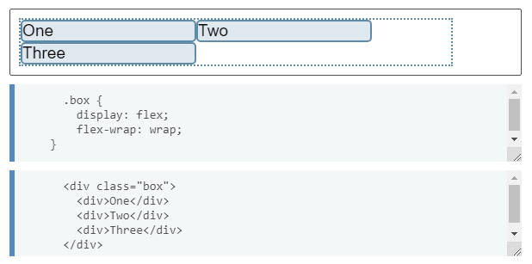
Multi-line flex containers with flex-wrap
While flexbox is a one dimensional model, it is possible to cause our flex items to wrap onto multiple lines.
To cause wrapping behaviour add the property flex-wrap with a value of wrap.
Now, should your items be too large to all display in one line, they will wrap onto another line.
Notes:
https://developer.mozilla.org/en-US/docs/Web/CSS/CSS_Flexible_Box_Layout/Basic_Concepts_of_Flexbox

Slide 26
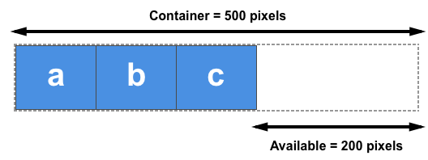
Available Space
The flex-basis property defines the normal size of an item in terms of the spaces that is available. (Defaults to auto)
The flex-grow property sepecifies what proportion of the available space that an item will grow to occupy. (Defaults to 0)
The flex-shrink property specifies the proportion of space to give up when there is not enough space in the container. (Defaults to 1)
Notes:
https://developer.mozilla.org/en-US/docs/Web/CSS/CSS_Flexible_Box_Layout/Basic_Concepts_of_Flexbox

Slide 27
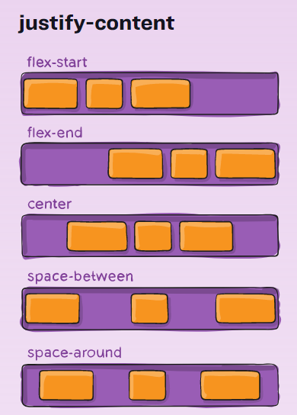
Alignment
Align flex items on the main axis using the justify-content property
possible values: flex-start, flex-end, center, space-between, space-around
default: flex-start
Align flex items on the cross axis using the align-items property
possible values: stretch, flex-start, flex-end, center, baseline
default: stretch
Align wrapped lines within their container using the align-content property
possible values: stretch, flex-start, flex-end, center, space-between, space-around
default: stretch
Notes:
https://developer.mozilla.org/en-US/docs/Web/CSS/CSS_Flexible_Box_Layout/Basic_Concepts_of_Flexbox

Slide 28
Center Anything
The Flexbox alignment properties allow us to center anything both vertically and horizontally.
<div style="display: flex; min-height: 600px;">
<div style="justify-content: center; align-items: center;">
Centered Content Here
</div>
</div>
Notes:
https://developer.mozilla.org/en-US/docs/Web/CSS/CSS_Flexible_Box_Layout/Basic_Concepts_of_Flexbox

Slide 29
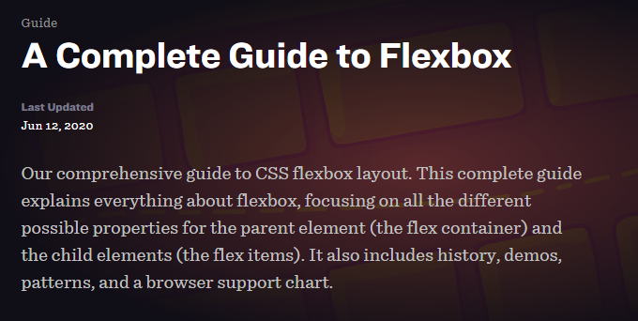
A Complete Guide to Flexbox
See https://css-tricks.com/snippets/css/a-guide-to-flexbox/
for a complete and thorough explanation of flexbox (with helpful pictures.)

Slide 30
CSS Selectors
Using selectors to pick what elements to style.

Slide 31
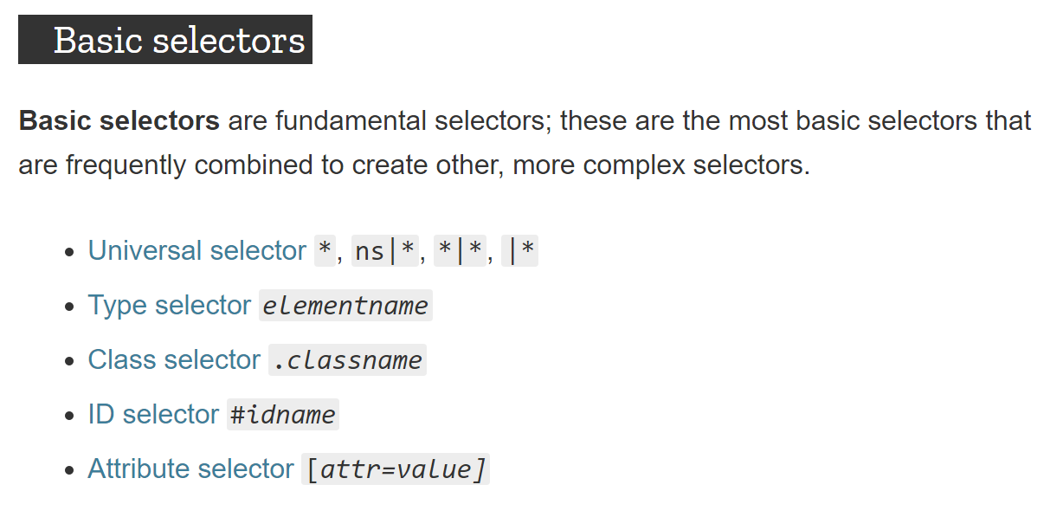
https://developer.mozilla.org/en-US/docs/Web/CSS/Reference#Basic_selectors
Notes:
https://developer.mozilla.org/en-US/docs/Web/CSS/Reference#Basic_selectors

Slide 32
Universal Selector
The universal selector (*) matches elements of any type.
Example CSS
* { color: green; }
Example HTML
<h1>This header will be green.</h1>
<h2>This header will also be green.</h2>
<p>This paragraph will also be green.</p>
Notes:
https://developer.mozilla.org/en-US/docs/Web/CSS/Universal_selectors

Slide 33
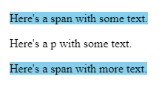
Type Selector
The type selector matches elements by node name.
In other words, it selects all elements of the given type within a document.
Example CSS
span { background-color: skyblue; }
Example HTML
<span>Here's a span with some text.</span>
<p>Here's a p with some text.</p>
<span>Here's a span with more text.</span>
Result
Notes:
https://developer.mozilla.org/en-US/docs/Web/CSS/Type_selectors

Slide 34
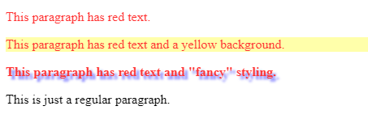
Class Selector
The class selector matches elements based on the contents of their class attribute.
Example CSS
.red { color: red; }
.bg-yellow { background: yellow; }
.fancy { font-weight: bold; text-shadow: 4px 4px 3px #77f; }
Example HTML
<p class="red">This paragraph has red text.</p>
<p class="red yellow-bg">This paragraph has red text and a yellow background.</p>
<p class="red fancy">This paragraph has red text and "fancy" styling.</p>
<p>This is just a regular paragraph.</p>
Result
Notes:
https://developer.mozilla.org/en-US/docs/Web/CSS/Class_selectors

Slide 35

ID Selector
The ID selector matches an element based on the value of the element’s id attribute.
Example CSS
#identified { background-color: skyblue; }
Example HTML
<div id="identified">This div has a special ID on it!</div>
<div>This is just a regular div.</div>
Result
Notes:
https://developer.mozilla.org/en-US/docs/Web/CSS/ID_selectors

Slide 36
Attribute Selector
The attribute selector matches elements based on the presence or value of a given attribute.
Example CSS
a { color: blue; } /* Regular link */
a[title] { background-color: gold; } /* Link with tooltip */
a[href="https://example.org"] { color: green; } /* Link to example.org homepage */
a[href^="#"] { color: red; } /* Internal link */
Example HTML
<a href="gallery.html">Regular link</a>
<a href="shiny.html" title="shiny">Link with tooltip</a>
<a href="https://example.org" target="_blank">example.org</a>
<a href="#internal">Internal link</a>
Notes:
https://developer.mozilla.org/en-US/docs/Web/CSS/Attribute_selectors

Slide 37
Pseudo-classes
A pseudo-class specifies a special state of the selected elements.
For example, :hover can be used to change a button's color when the user's pointer hovers over it.
pseudo-class description
:hover Triggered when the mouse hovers over an element with the cursor.
:focus The element that currently has focus.
:focus-within An element that has focus or contains the element that has focus.
:first-child The first element among a group of sibling elements.
:last-child The last element among a group of sibling elements.
:nth-child(odd) The sibling elements with an odd numeric position. (1,3, 5, etc.)
:nth-child(even) The sibling elements with an even numeric position. (2,4, 6, etc.)
https://developer.mozilla.org/en-US/docs/Web/CSS/Pseudo-classes
Notes:
https://developer.mozilla.org/en-US/docs/Web/CSS/Pseudo-classes

Slide 38
Pseudo-elements
A pseudo-element lets you style a specific part of the selected elements.
For example, ::first-line can be used to change the font of the first line of a paragraph.
pseudo-element description
::first-line The first line of text in a block-level element.
::first-letter The first letter of text in a block-level element.
::before Creates a pseudo-element that is the first child of the selected element.
::after Creates a pseudo-element that is the last child of the selected element.
NOTE: The ::before and ::after pseudo-element rules must include the content property.
https://developer.mozilla.org/en-US/docs/Web/CSS/Pseudo-elements
Notes:
https://developer.mozilla.org/en-US/docs/Web/CSS/Pseudo-elements

Slide 39
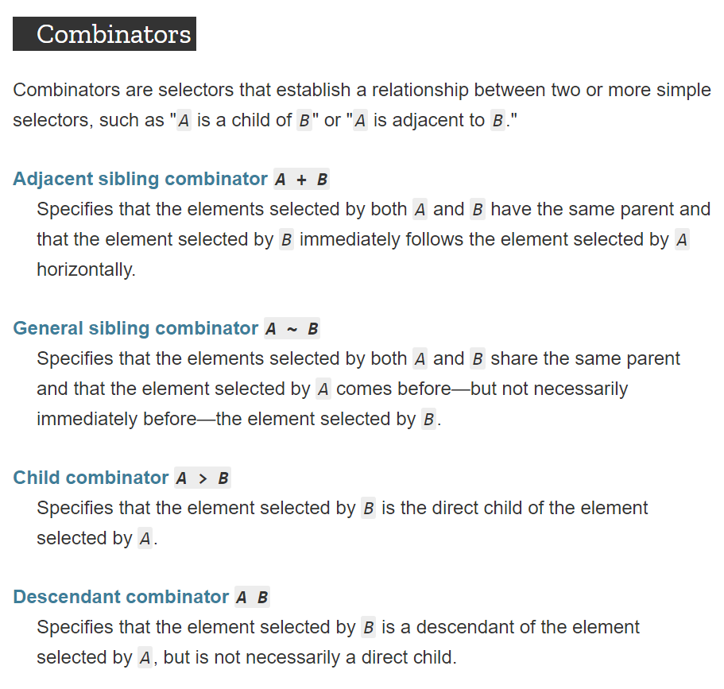
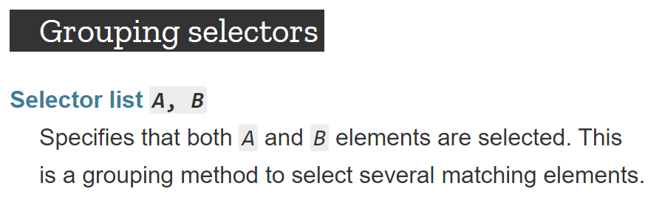
https://developer.mozilla.org/en-US/docs/Web/CSS/Reference#Basic_selectors
Notes:
https://developer.mozilla.org/en-US/docs/Web/CSS/Reference#Basic_selectors

Slide 40
CSS Colors
text, background, and border colors

Slide 41
CSS Color Values
Color values can be specified several ways in CSS:
by name [e.g. lime]
by 3 digit hex code [e.g. #0f0]
by 6 digit hex [e.g. #00ff00]
by rgb/rgba values [e.g. rgba(0, 255, 0, 1.0)]
by hsl/hsla values [e.g. hsla(120, 100%, 50%, 1.0)]
Notes:
https://developer.mozilla.org/en-US/docs/Web/CSS/color_value

Slide 42
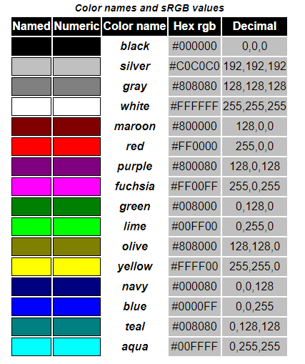
Color Keywords
The list of basic color keywords is:
aqua, black, blue, fuchsia, gray, green, lime, maroon, navy, olive, purple, red, silver, teal, white, and yellow.
Notes:
https://drafts.csswg.org/css-color-3/#html4

Slide 43
RGB
Colors can be specified in terms of the Red-Green-Blue (RGB) color spectrum in a few ways.
3 digit hex code
#RGB where R, G, B range from 0 to f
6 digit hex code
#RRGGBB where RR, GG, BB range from 00 to ff
rgb()
rgb(R, G, B) where R, G, B range from 0 to 255
rgba()
rgba(R, G, B, A) where R, G, B range from 0 to 255, and A ranges from 0.0 to 1.0
Notes:
https://developer.mozilla.org/en-US/docs/Web/CSS/color_value

Slide 44
HSL
HSL stands for hue, saturation, and lightness.
Hue is measured in degrees from 0 to 359
Saturation is measured as a % where 100% is full hue and 0% is a shade of gray.
Lightness is measured as a % where 100% is white, 0% is black, and 50% lightness is "normal."
Makes it easier for designers to adjust color values.
Examples
hsl( 0, 100%, 50%) /* red */
hsl(120, 100%, 50%) /* green */
hsl(240, 100%, 50%) /* blue */
hsl( 0, 100%, 100%) /* white */
hsl( 0, 100%, 0%) /* black */
Notes:
https://developer.mozilla.org/en-US/docs/Web/CSS/color_value

Slide 45
color property
The color property changes the text color.
color is inherited by child elements.
Examples
h1 { color: green; }
h2 { color: #00ff00; }
h3 { color: hsl(120, 100%, 50%); }
Notes:
https://developer.mozilla.org/en-US/docs/Web/CSS/color_value

Slide 46
background-color property
The background-color property changes the background color.
Examples
h1 { background-color: green; }
h2 { background-color: #00ff00; }
h3 { background-color: hsl(120, 100%, 50%); }
Notes:
https://developer.mozilla.org/en-US/docs/Web/CSS/color_value

Slide 47
border-color property
The border-color property changes the border color.
Examples
h1 { border-color: green; }
h2 { border-color: #00ff00; }
h3 { border-color: hsl(120, 100%, 50%); }
Notes:
https://developer.mozilla.org/en-US/docs/Web/CSS/color_value

Slide 48
Fonts
Styling text

Slide 49
font-family property
The font-family property specifies a prioritizes list of one or more font family names.
Set this on the html element to change the default font for the entire page.
font-family is inherited by child elements.
Always provide a fallback font family such as: serif, sans-serif, monospace
Examples
html { font-family: Arial, Helvetica, sans-serif; }
h1, h2, h3 { font-family: Times, "Times New Roman", serif; }
code { font-family: Consolas, Courier, monospace; }
Notes:
https://developer.mozilla.org/en-US/docs/Web/CSS/font-family

Slide 50
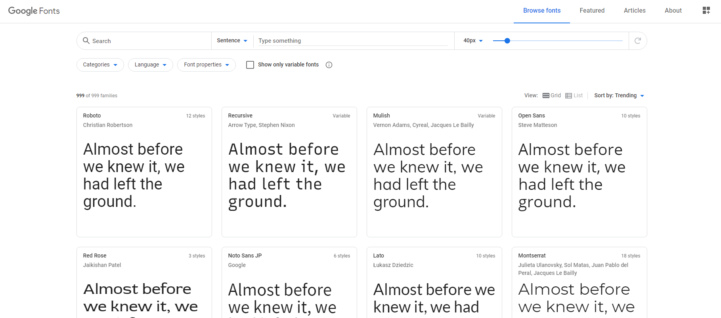
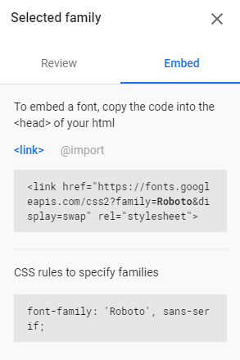
Google Fonts
For fonts beyond the generic font families of sans-serif, serif, and monospace
use Google Fonts [https://fonts.google.com/]
Notes:
https://developer.mozilla.org/en-US/docs/Web/CSS/font-family

Slide 51
font-size property
The font-size property changes the size of the text.
font-size should be measured with em or rem.
font-size is inherited by child elements.
Do not use px for font sizes!
Examples
h1 { font-size: 2rem; }
h2 { font-size: 1.75rem; }
h3 { font-size: 1.5rem; }
p { font-size: 1rem; }
Notes:
https://developer.mozilla.org/en-US/docs/Web/CSS/font-size

Slide 52
line-height property
The line-height property changes the height of a line of text.
line-height should be specified as a unitless multiple of the font-size.
line-height is inherited by child elements.
Do not use px for line heights!
Examples
h1 { line-height: 2; }
h2 { line-height: 1.75; }
h3 { line-height: 1.5; }
p { line-height: 1.2; }
Notes:
https://developer.mozilla.org/en-US/docs/Web/CSS/line-height

Slide 53
font-weight property
The font-weight property changes the weight (or boldness) of the font.
font-weight can be specified as a keyword: normal, bold, bolder, light, lighter
font-weight can be specified as a number from 100 (lightest) to 900 (boldest)
font-weight is inherited by child elements.
font-weight: bold; is not noticeably different from normal with some fonts.
Examples
h1, h2, h3 { font-weight: bolder; }
strong { font-weight: bolder; }
Notes:
https://developer.mozilla.org/en-US/docs/Web/CSS/font-weight

Slide 54
text-decoration property
The text-decoration property sets the appearance of decorative lines on text.
text-decoration is often used to highlight links that are interactable.
Examples
a { text-decoration: none; }
a:hover, a:focus { text-decoration: underline; }
.strikethrough { text-decoration: line-through; }
Notes:
https://developer.mozilla.org/en-US/docs/Web/CSS/text-decoration

Slide 55
Conclusion
What did we learn today?

Slide 56
What We Covered
Apply styles with Inline Styles, Embedded Stylesheets, and External Stylesheets
Understand the CSS Box Model
Use CSS Flexbox to implement page layouts
Use the main CSS selectors: type, class, id
Use CSS relational selectors: descendent and direct descendent
Use CSS properties to change background and foreground colors
Use CSS properties to style text

Slide 57
Some Useful URLs
MDN Learn: CSS First Steps
MDN Docs: Basic Selectors, Grouping Selectors, and Combinators
MDN Docs: box-sizing
MDN Docs: Basic Concepts of Flexbox
CSS Tricks: A Complete Guide to Flexbox
MDN Docs: color value
MDN Docs: font attribute
Adobe Color Wheel
Google Fonts

